Slide 1

WIDE WORLD IMPORTERS
Service/Solution
Atharva Shirsalkar | Assistant Associate
Nagpur | 2nd June 2023
Classification: Confidential

Slide 2
Agenda
Objective
Approach
Requirement Analysis and Questionnaire
LDM and PDM
Custom SQL for Data testing
MSTR Configuration & Project Setup
Reports and Dossier
Issues faced & Lessons learnt

Slide 3
Objective
01

Slide 4
Objectives
WWI is a fictious wholesale novelty goods importer and distributor operating from the San Francisco bay area by Microsoft.
The main objective of WWI is to generate sales by providing customers with the products they want and need. Retailers aim to sell as much inventory as possible to generate revenue.
These reports will help them to drive their business flow seamlessly with Time wise Sales & Profit Analysis.

Slide 5
Approach
02

Slide 6
Approach
Industry Study
Requirement & Analysis
OLTP & Data Modelling
LDM & PDM
OLAP Database(ETL)
Reports & Dossier
Schema & Public Objects
MSTR Config & Setup
ODBC Connections
Custom SQL
(Data Testing)

Slide 7
Requirement Analysis and Questionnaire
03

Slide 8
Business Requirement Documents
Sales and Profit Analysis by Sales Territory and Year : This report is used to compare Total Inc Tax, Quantity and Profit for a given Sales Territory and year with last year.
Top 5 State Province | Top 5 Customers | Top 5 Employees for a selected Fiscal Year : The objective is to display the Top performing State Province, High value Customers and High performing Employees in a single report.
Sales for Time and Geography : This report displays Total Exc Tax and Quantity for selected Time period and Geography.
Item ordered but never Picked up for delivery by Month: This report displays Stock Item wise Sales and Unit Sold for all Stock item for which order was placed but they were not picked up for delivery during every month.
Alert report | Current inventory less than the Target Inventory: This report is sent out alert to users with the list of items where the current on hand inventory is less than the Target Inventory.
Contribution of each City to its Territory and Province : The objective is to display the contribution that each city makes excl taxes to it State Province and State Territory

Slide 9
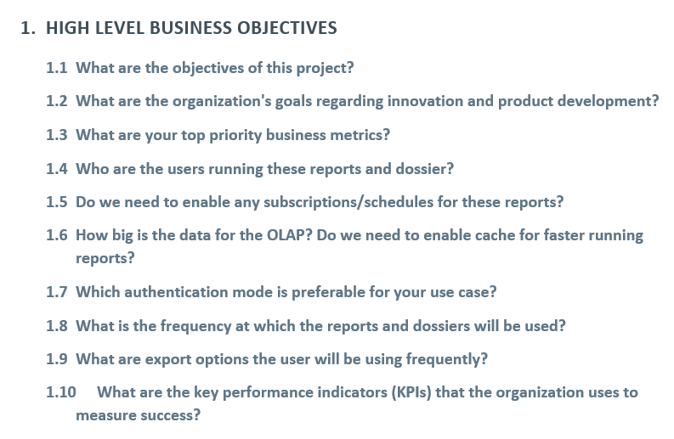
Questionnaire

Slide 10
LDM & PDM
04

Slide 11
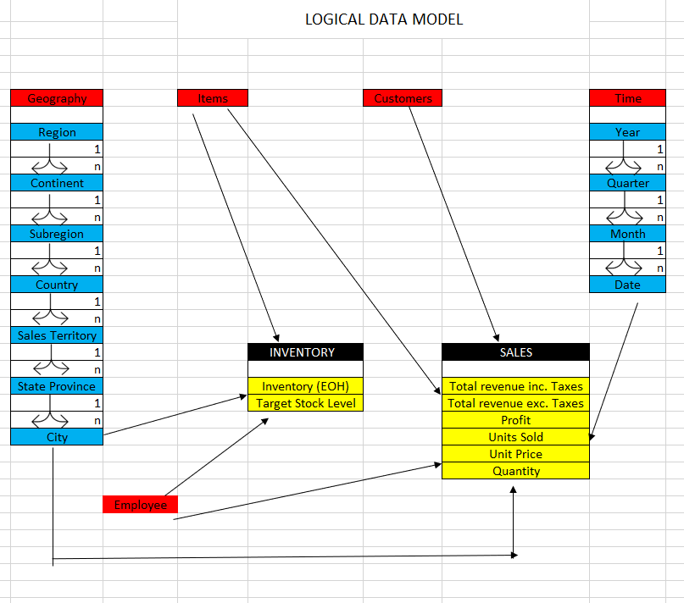
Logical Data Model

Slide 12
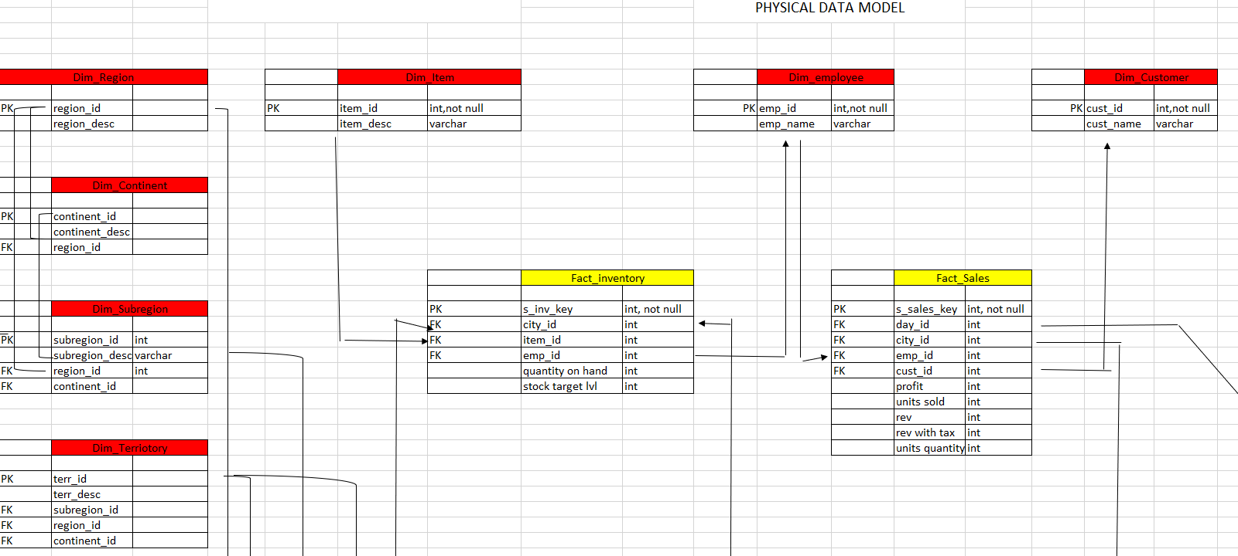
Physical Data Model

Slide 13
Custom SQL
05

Slide 14
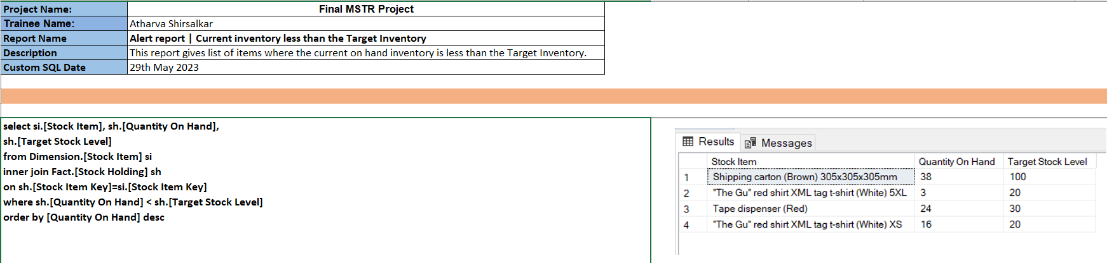
Custom SQL

Slide 15
MSTR Configuration
& Project Setup
06

Slide 16
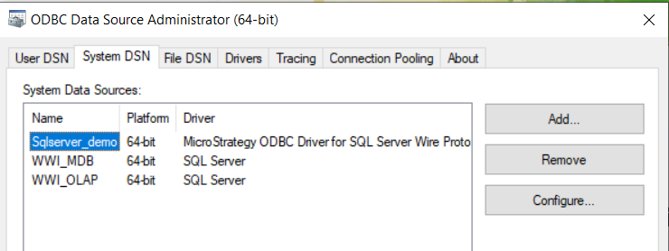
ODBC Connections & DBI Creation

Slide 17
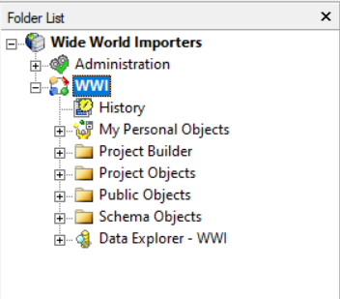
MSTR PROJECT

Slide 18
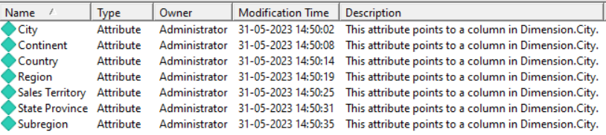
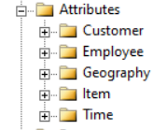
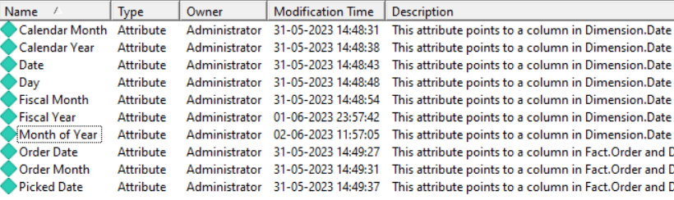
SCHEMA OBJECTS

Slide 19

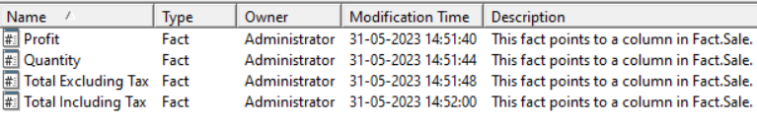

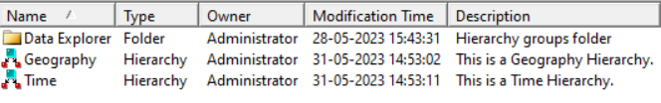
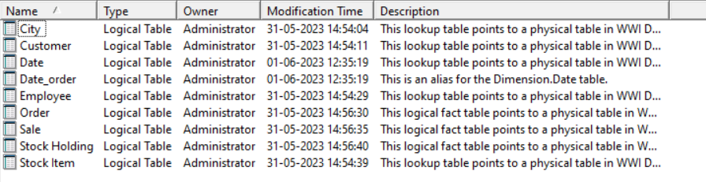

SCHEMA OBJECTS

Slide 20





APPLICATION OBJECTS

Slide 21
APPLICATION OBJECTS

Slide 22
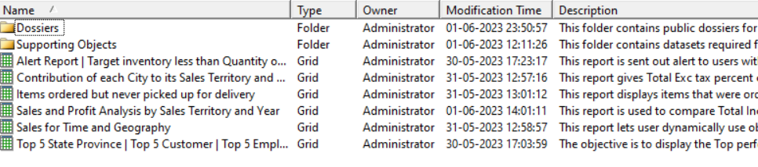

APPLICATION OBJECTS

Slide 23
Reports & Dossier
07

Slide 24
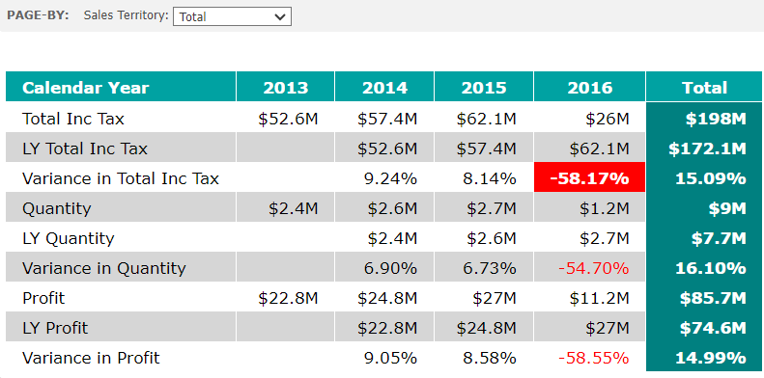
Sales and Profit Analysis by Sales Territory and Year

Slide 25
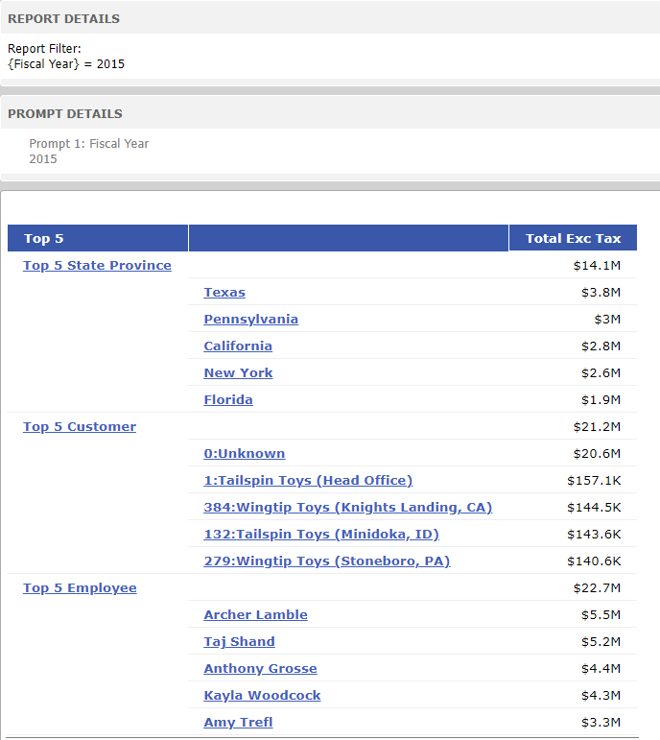
Top 5 State Province, Customers, Employees by Fiscal Year

Slide 26
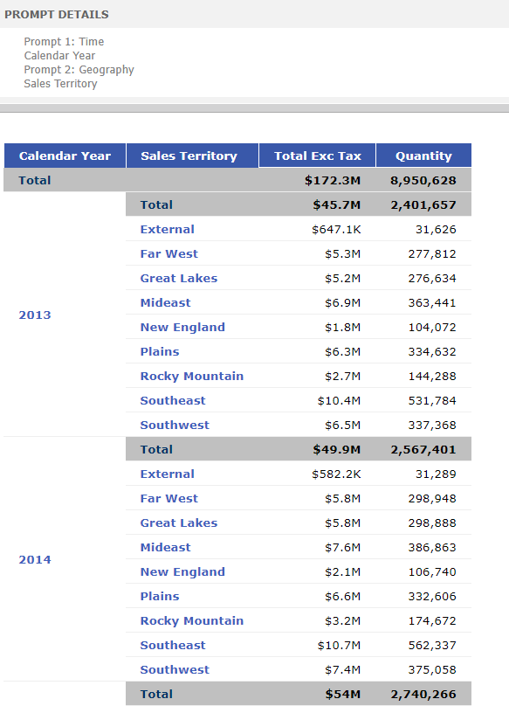
Sales for Time and Geography

Slide 27
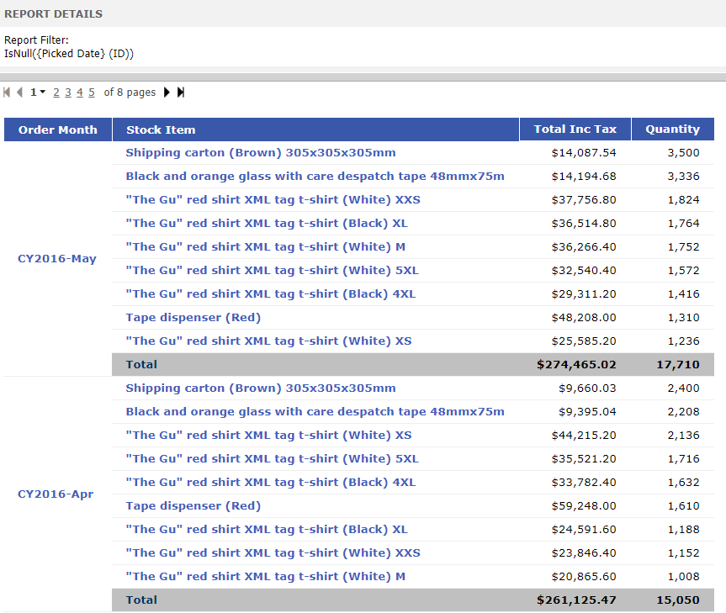
Item ordered but never picked up

Slide 28
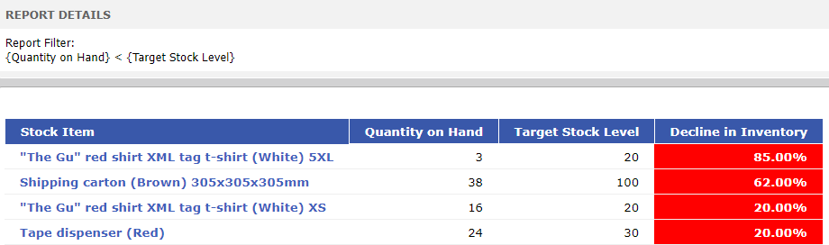
Alert Report | Target inventory less than Quantity on Hand

Slide 29
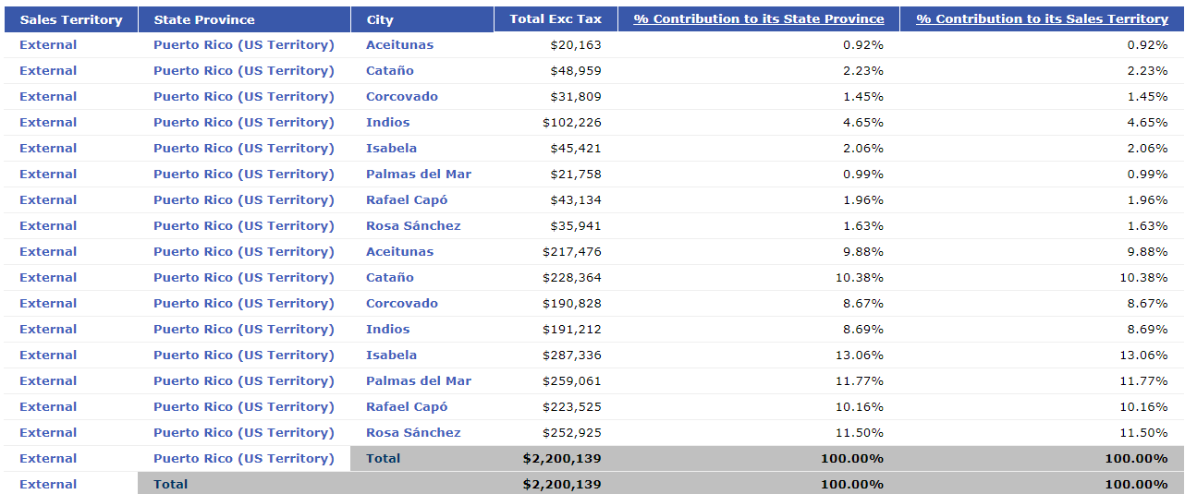
Contribution of each City to its Territory and Province

Slide 30
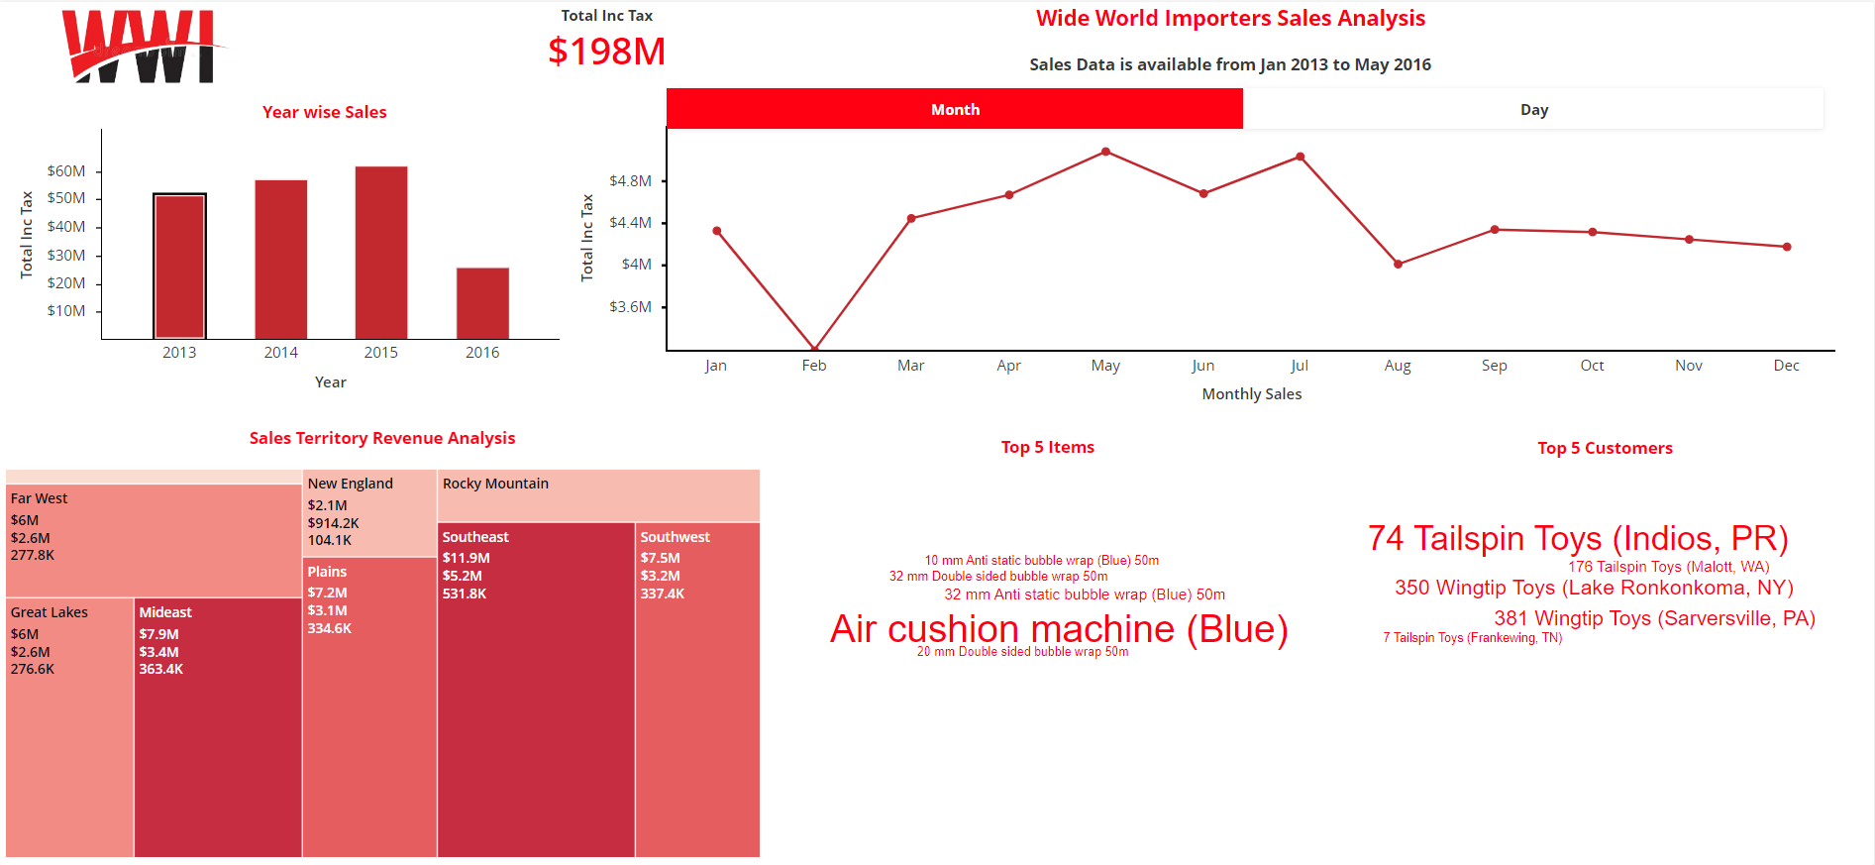
DOSSIER

Slide 31
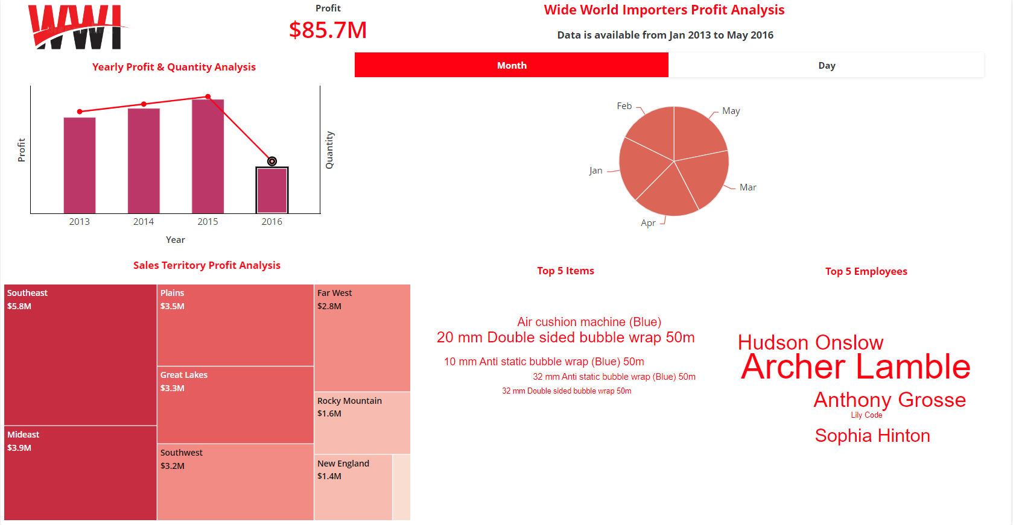
DOSSIER

Slide 32
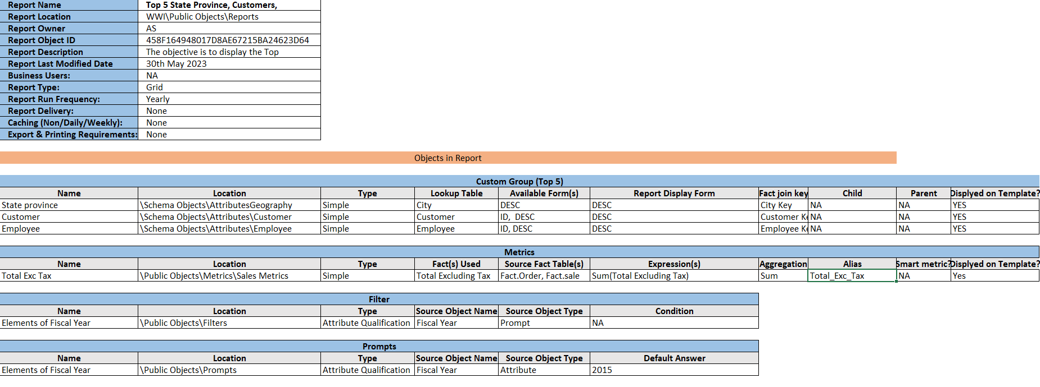
REPORT DETAILS

Slide 33
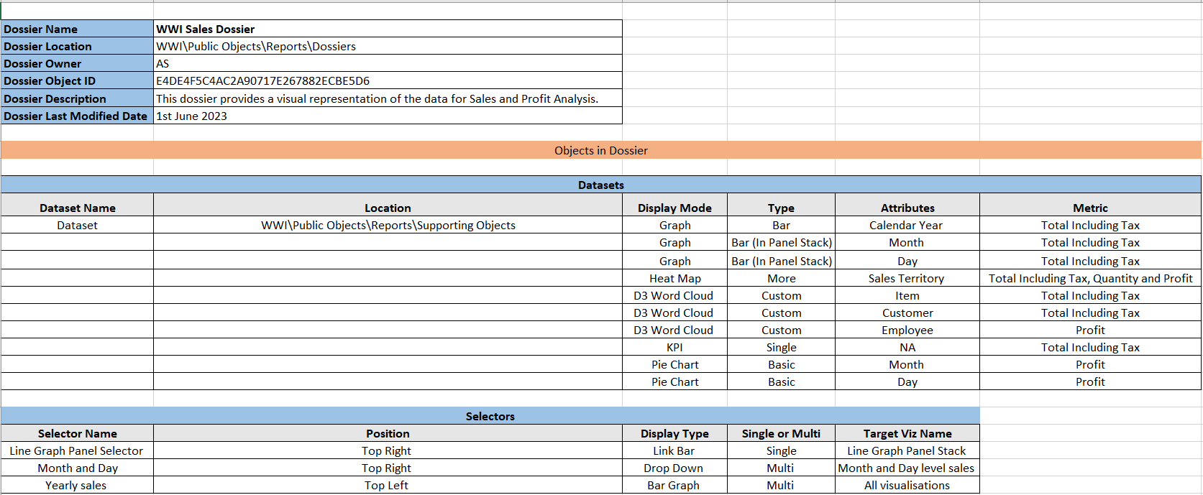
DOSSIER DETAILS

Slide 34
Issues Faced &
Lessons Learned
08

Slide 35
Issues
Lessons
Invalid Object names
Cartesian Join Governing ( Report execution failed )
Fact cross join attribute error &Fact not available at required level
Metrics showing data using default join
Heterogenous attributes linking error
MSI Session logout
Importing prefixes of tables
Fact & Attribute joining at grain level
Corrected the Invalid Hierarchy of attribute & Correction child – parent relationship
Changing default join to outer join (according to needs)
Create multiple form expressions of attributes with different names
Re-configuration of I-Server
https://community.microstrategy.com/s/?language=en_US (Tech Notes & KB)

